Slide 1
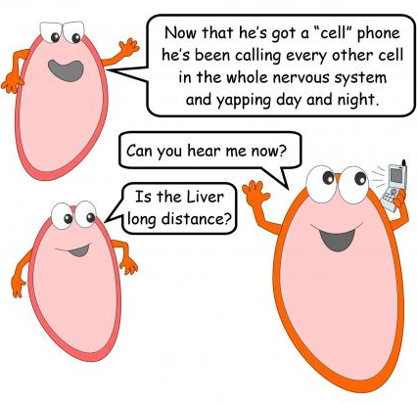

Slide 2
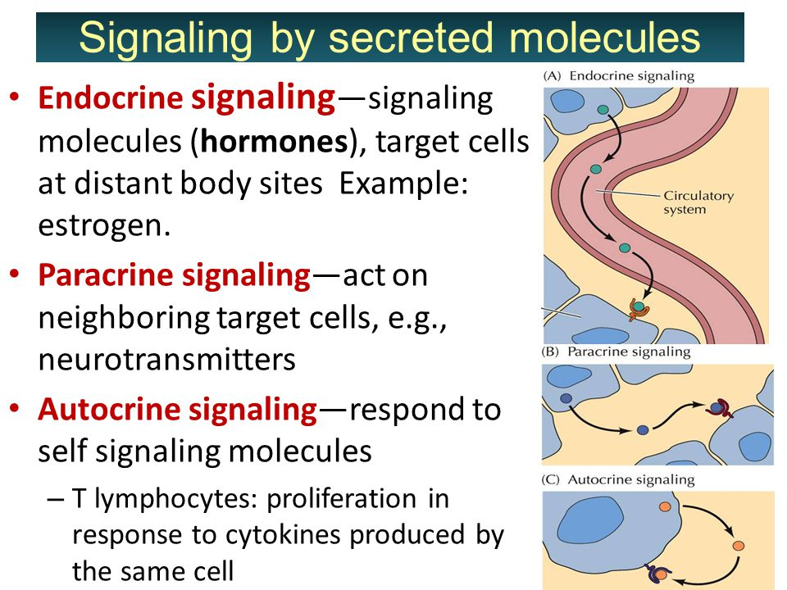

Slide 3
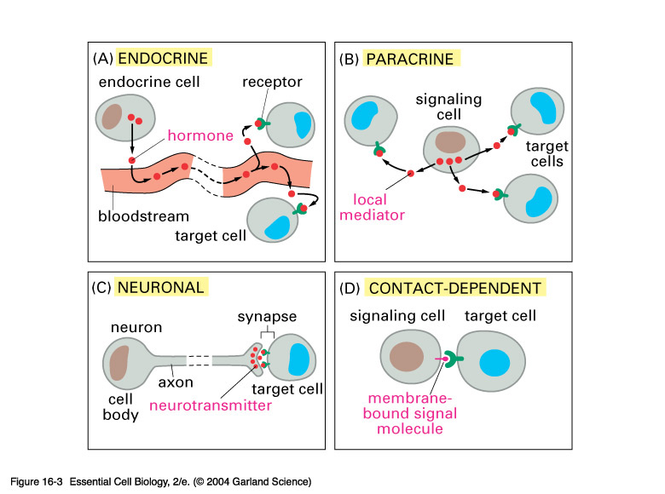
Types of Cell signaling

Slide 4
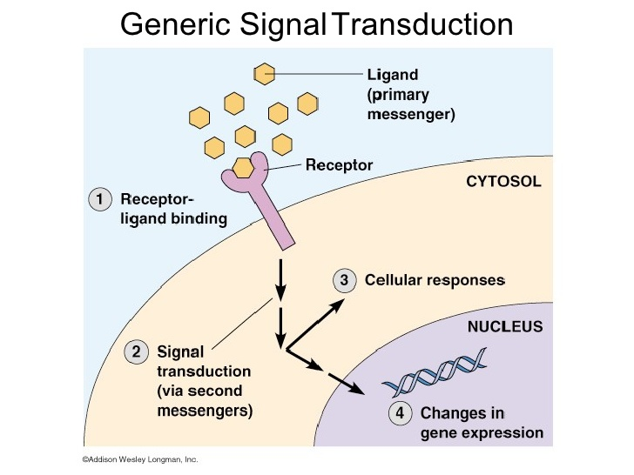
General process

Slide 5
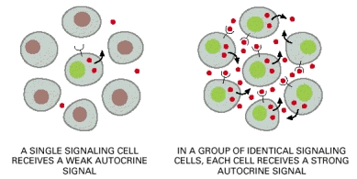
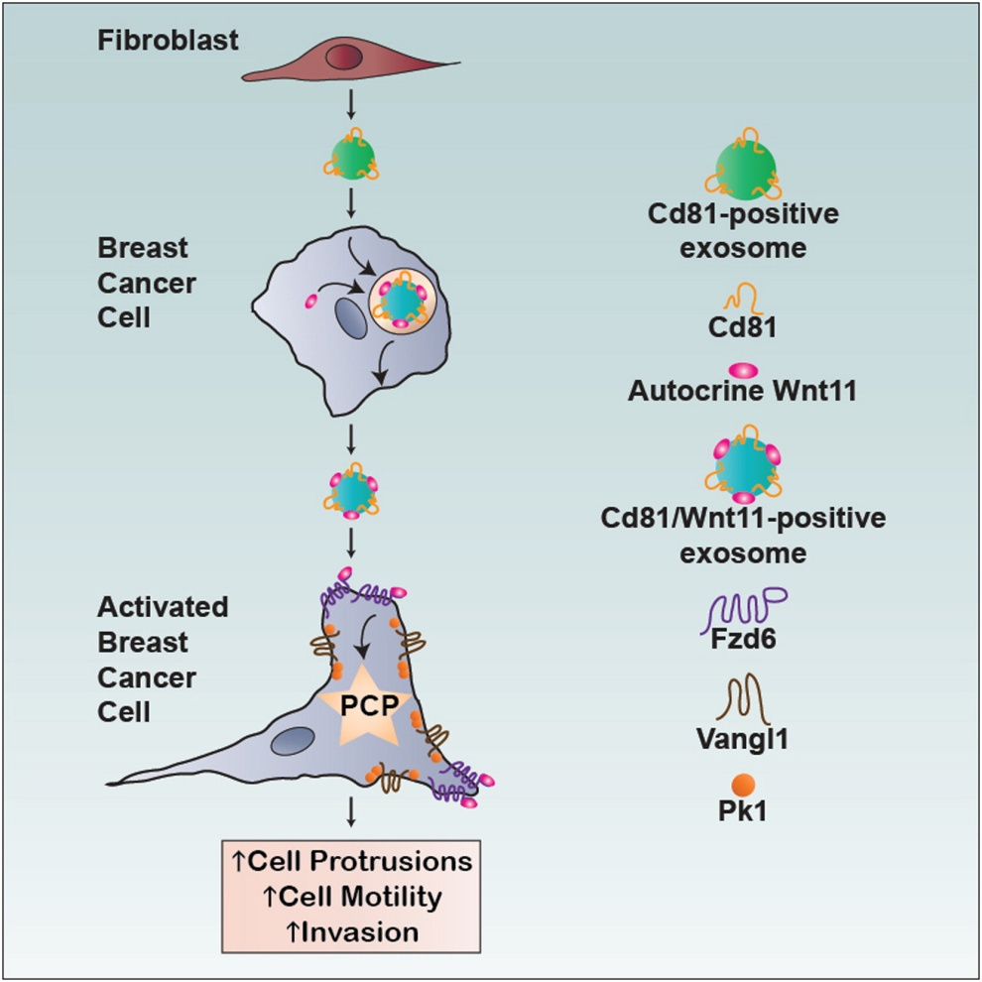
Autocrine signaling
Example 1: Activated T cell lymphocytes: Upon activation, "low-affinity" IL-2 receptors are replaced by "high-affinity" IL-2 receptors. The cell then releases IL-2, which binds to its own new IL-2 receptors, causing self-stimulation and ultimately a monoclonal population of T cells.
These T cells can then go on to perform effector functions such as macrophage activation, B cell activation, and cell-mediated cytoxicity.
Example 2

Slide 6
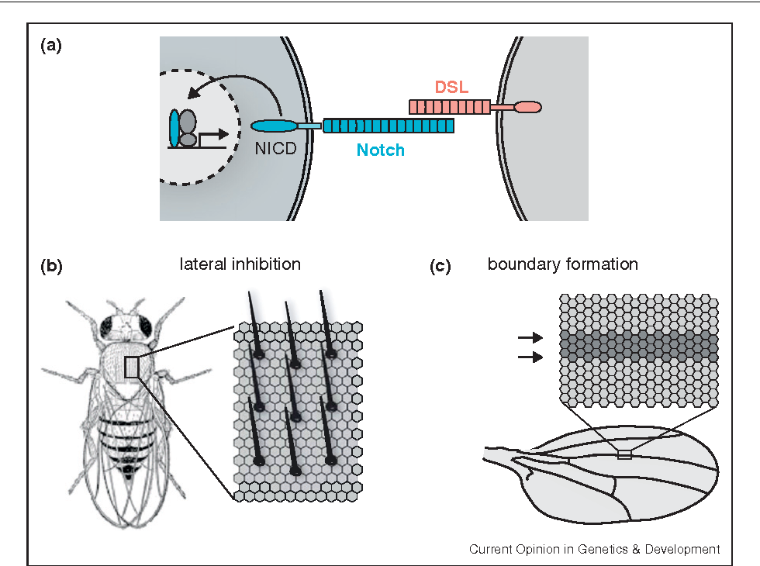
juxtacrine signaling: during development

Slide 7
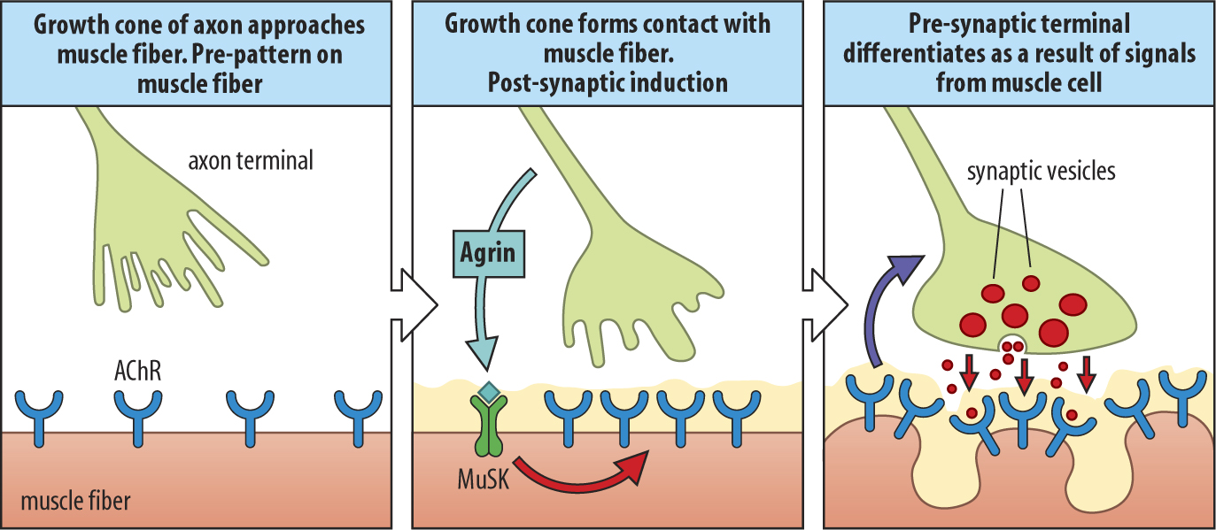
paracrine signaling: during development

Slide 8
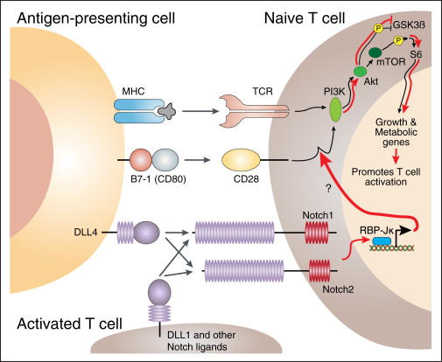
juxtacrine signaling: during immunity

Slide 9
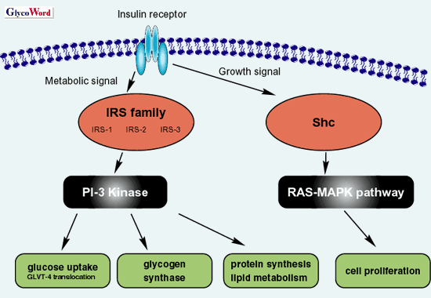
Insulin Signaling- multiple functions

Slide 10
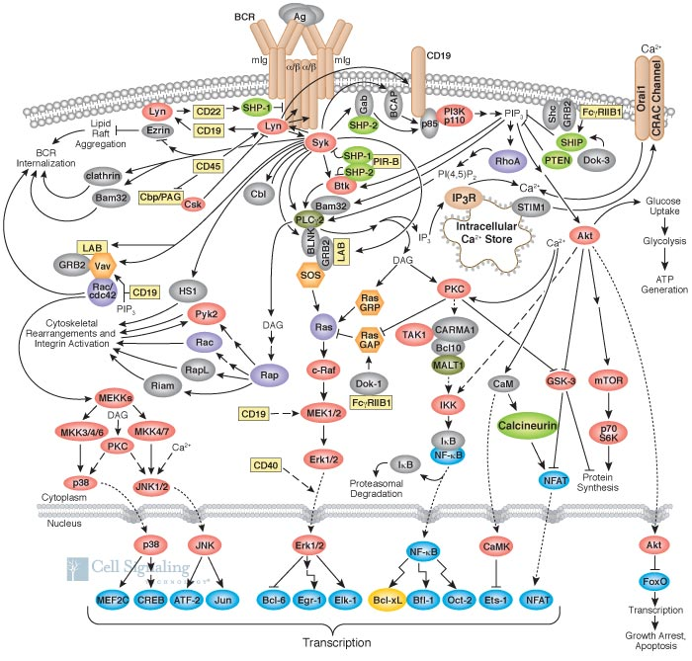

Slide 11
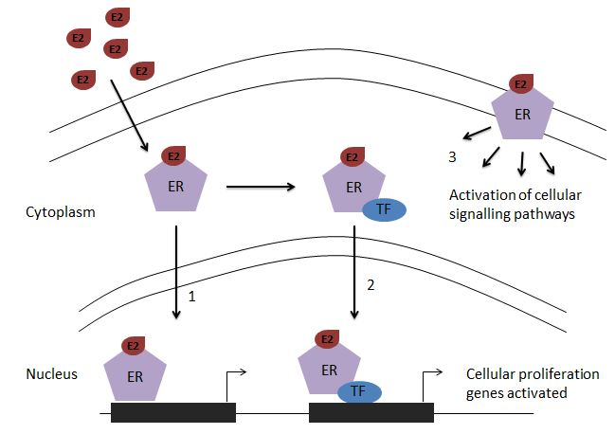
Endocrine Signaling- Estrogen

Slide 12
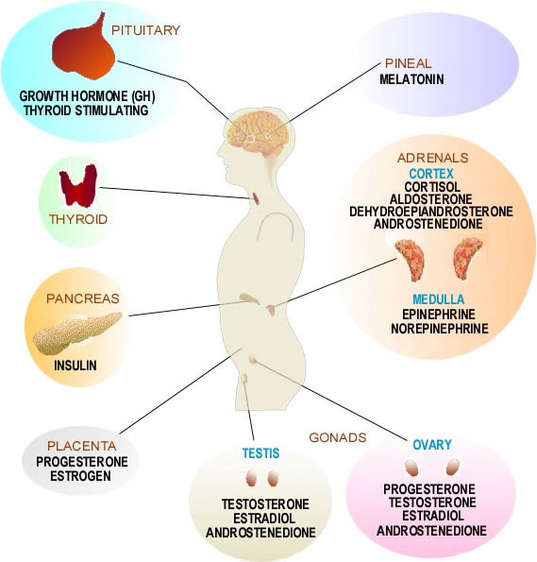
Endocrine System

Slide 13
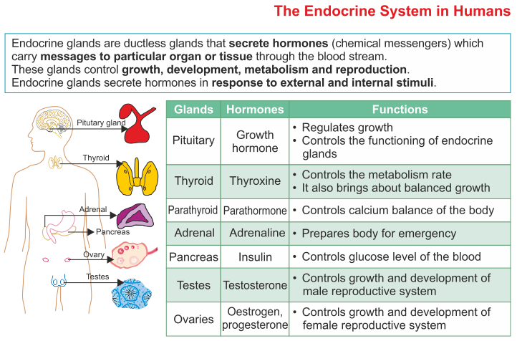
Endocrine System

Slide 14
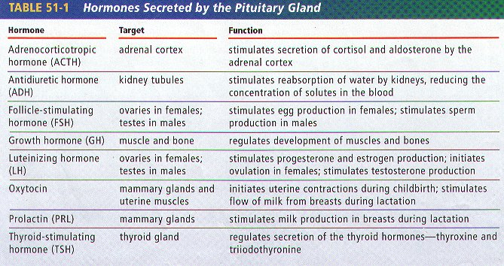
Hormones

Slide 15
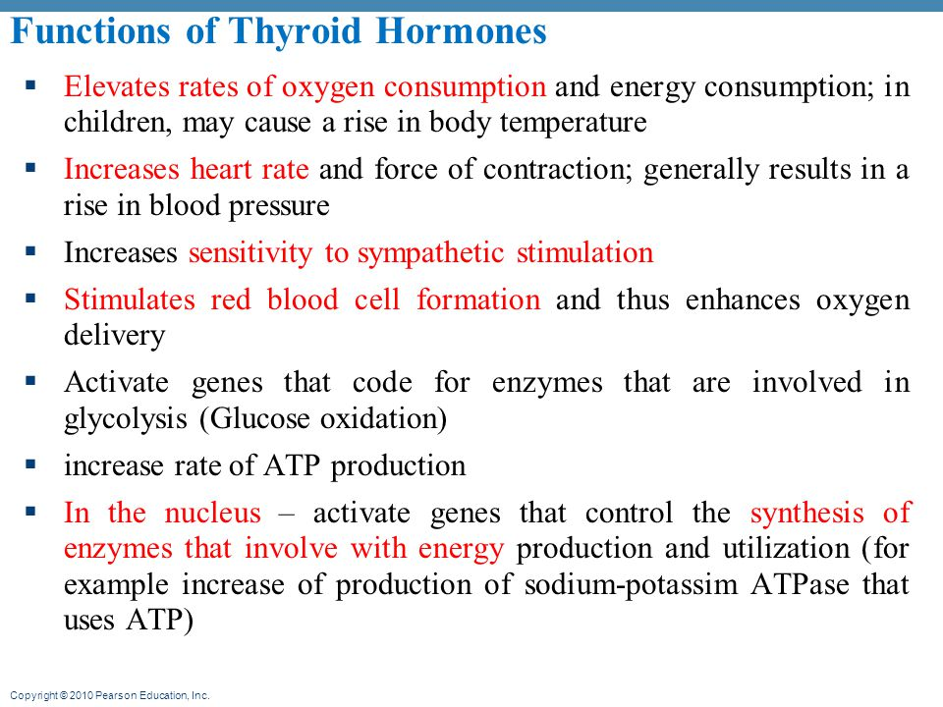

Slide 16
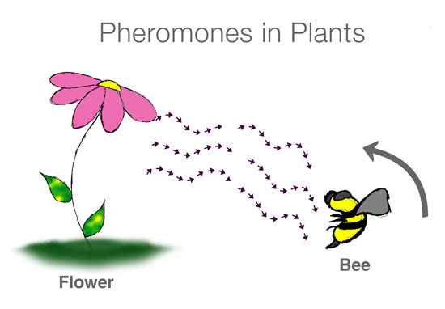
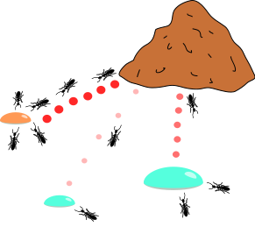
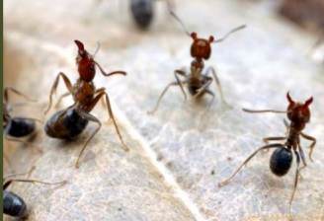
Pheromones

Slide 17
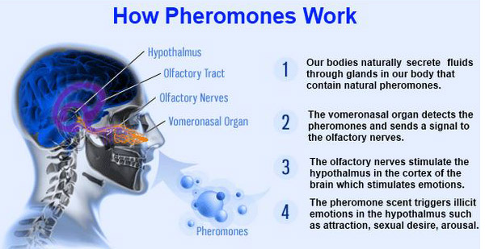
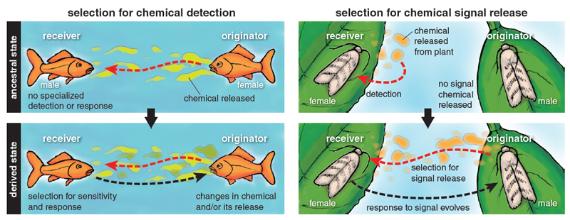

Slide 18
Cell-Cell Junctions

Slide 19
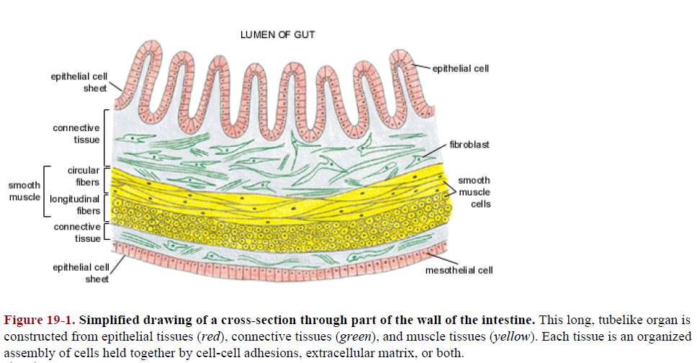
Cross-section to show cell arrangement in tissues

Slide 20
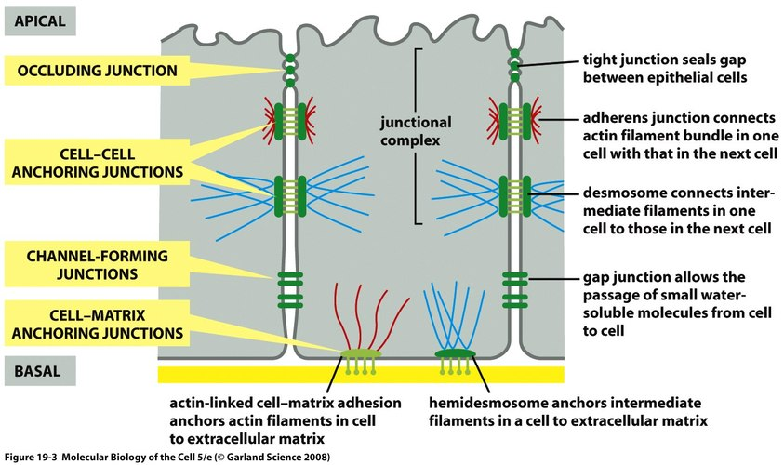
Types of Cell Junctions

Slide 21
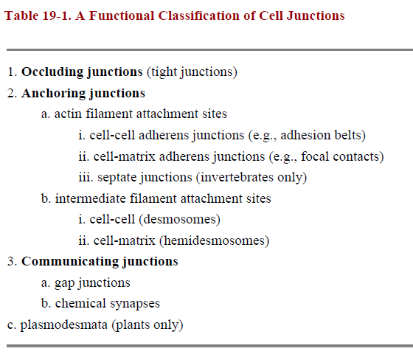

Slide 22
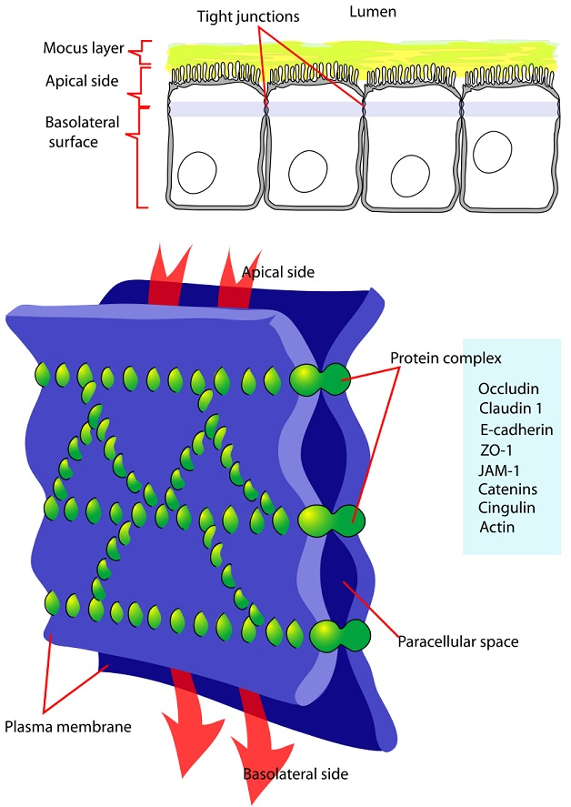
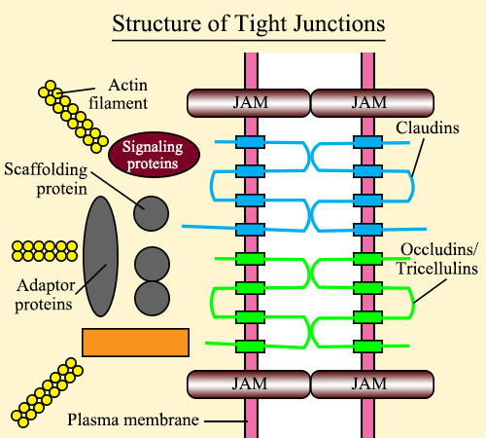
Tight junctions

Slide 23
Tight Junctions
Epithelial Cells- serve as selective permeability barriers, separating fluids on each side that have different chemical compositions. Tight junctions play two distinct roles in this selective-barrier function:
1. They function as barriers to the diffusion of membrane proteins between apical and basolateral domains of the plasma membrane.
2. they seal neighboring cells together so that water-soluble molecules cannot leak between the cells: if a low-molecular-weight tracer is added to one side of an epithelial cell sheet, it will usually not pass beyond the tight junction.

Slide 24
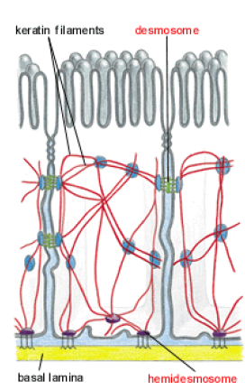
Anchoring Junctions
Anchoring junctions are widely distributed in animal tissues. They enable groups of cells, such as those in an epithelium, to function as robust structural units by connecting the cytoskeletal elements of a cell either to those of another cell or to the
extracellular matrix.
They are most abundant in tissues that are subjected to severe mechanical stress, such as heart muscle and skin epithelium (epidermis). They occur in three structurally and functionally different forms:
Adherens junctions : Adherens Junctions Connect Bundles of Actin Filaments from Cell to Cell or from Cell to Extracellular Matrix
Desmosomes and
(3) Hemidesmosomes : Desmosomes Connect Intermediate Filaments from Cell to Cell; Hemidesmosomes Connect Them to the Basal Lamina

Slide 25
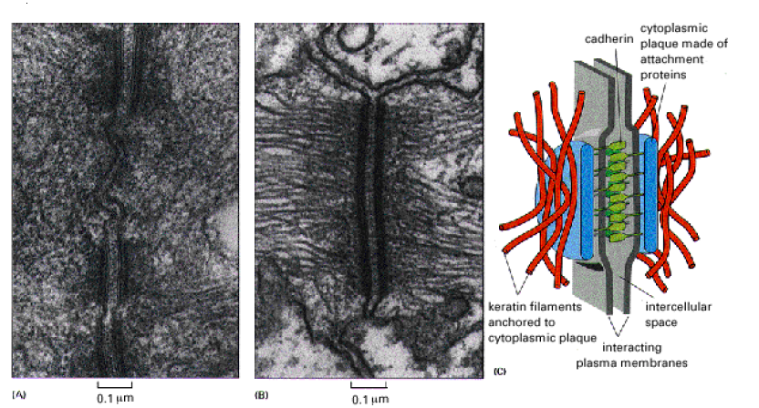

Slide 26
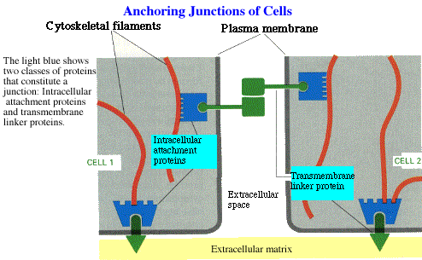

Slide 27
Gap Junction
Perhaps the most intriguing cell junction of all is the gap junction. It is one of the most widespread, being found in large numbers in most animal tissues and in practically all animal species.
This gap is spanned by channel-forming protein molecules that allow inorganic ions and other small water-soluble molecules to pass directly from the cytoplasm of one cell to the cytoplasm of the other, thereby coupling the cells both electrically and metabolically.
Electrical coupling between nerve cells allows action potentials to spread rapidly from cell to cell without the delay that occurs at chemical synapses; this is advantageous where speed and reliability are crucial, as in certain escape responses in fish and insects.

Slide 28
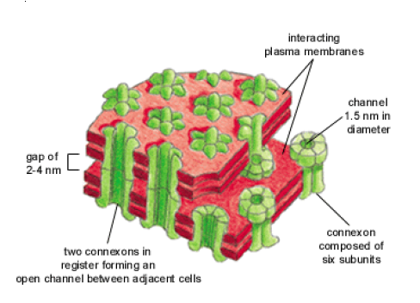
Gap Junction

Slide 29
Signaling effects on
Animal and Cell Behaviour

Slide 30
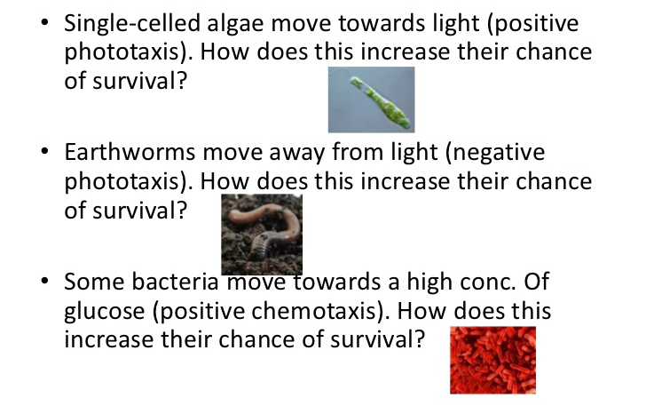

Slide 31
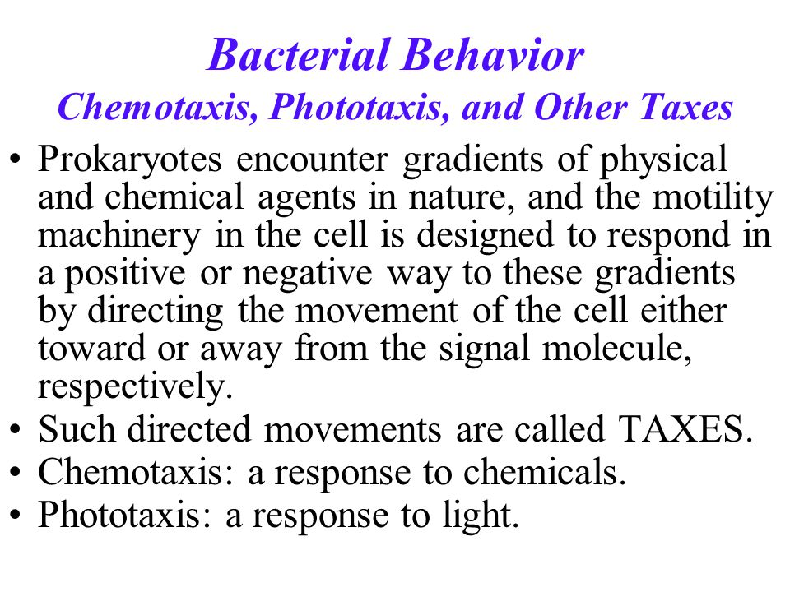
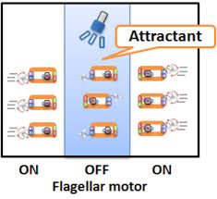

Slide 32
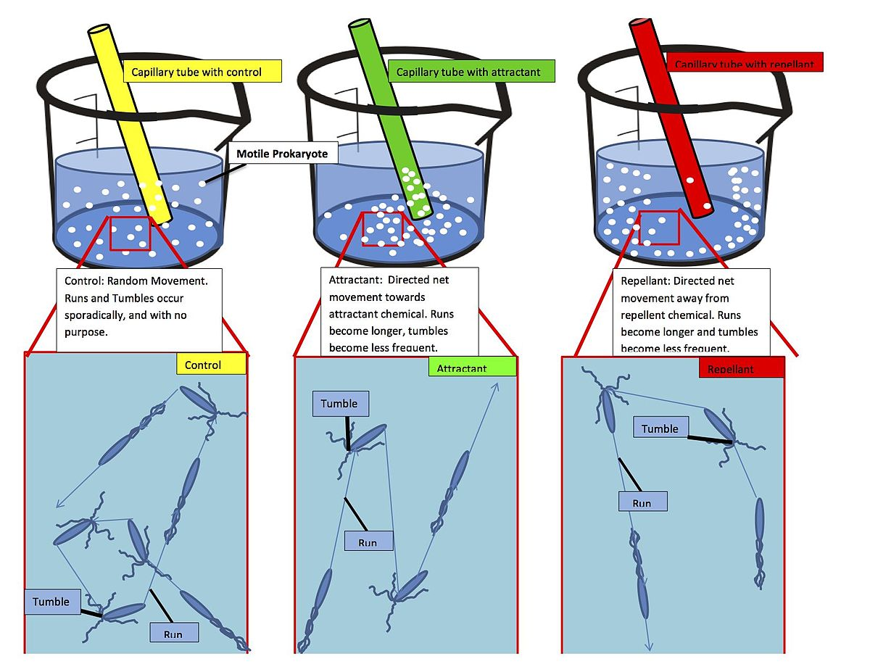

Slide 33
